Slide 1


Univariate & Multivariate
Dr. Hemalatha
AmritaWNA
Amrita Vishwa Vidyapeetham
Notes:
https://www.amrita.edu/news/amrita-surya-vahini-solar-auto-rickshaw

Slide 2
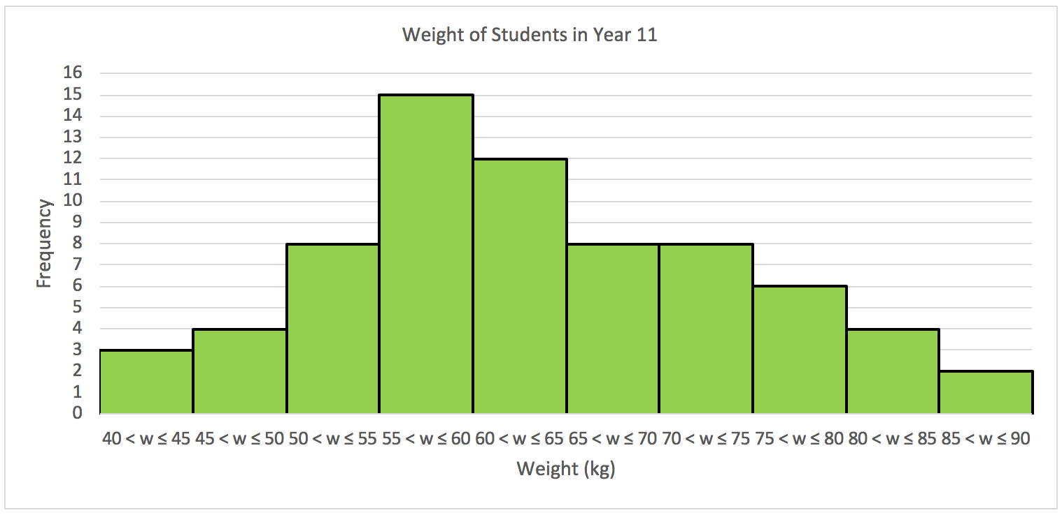
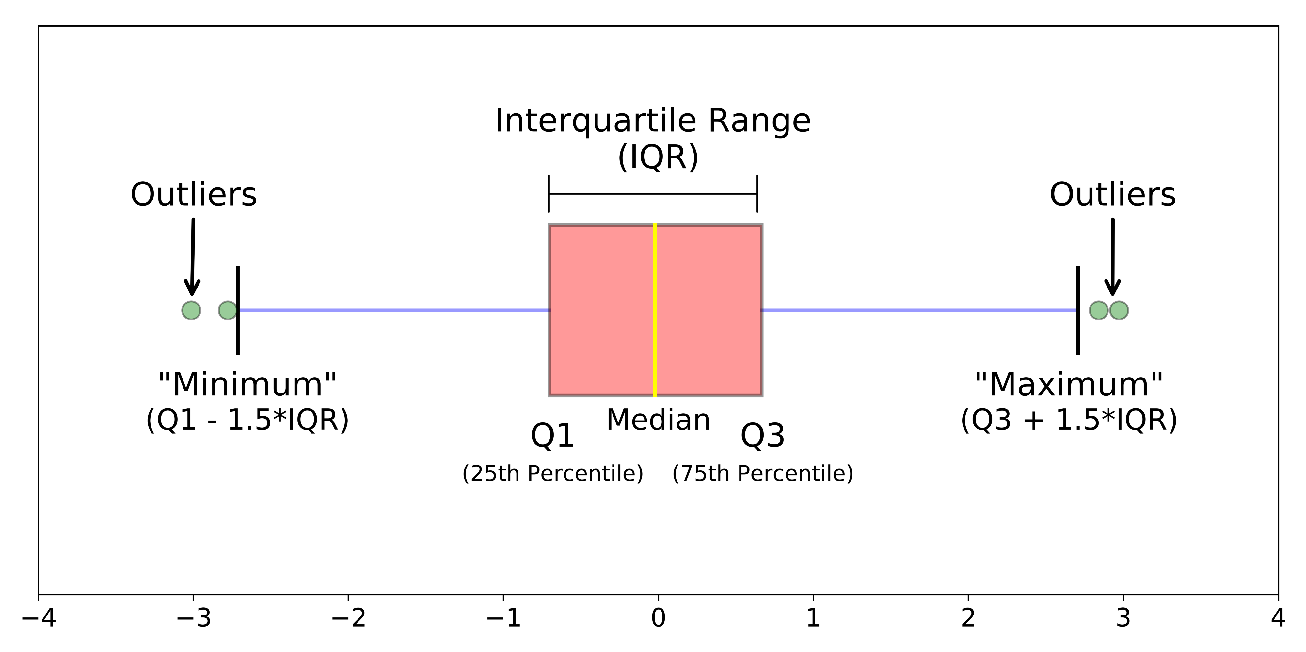
What is Univariate Analysis?
'Uni' refers to one, and 'variate' means variable, the word univariate refers to the analysis involving a single variable. The analysis can include summarization, measurements of dispersion, measurements of central tendency, and visualizations like histograms, distributions, frequency tables, bar charts, pie charts, boxplots, etc. The idea is simply that the data must contain a single variable, and it could be a categorical or numeric variable.
https://www.enjoyalgorithms.com/blog/univariate-bivariate-multivariate-analysis

Slide 3
What are the types of univariate analysis?
Frequency distribution analysis
This analysis is used to analyze continuous numerical data where we try to extract the statistical summary of the feature.
Maximum, minimum, and mean (average) analysis: Information like maximum, minimum, and mean values of any numerical data gives us a great impression of how that feature is distributed. Suppose we are analyzing the age of our customers. We saw that the minimum age of our customers is 18, the maximum age is 26, and the average age is 22. We can extract information that our customers are youth.
Standard deviation and variance analysis: We have the mean value from the earlier step. To analyze each sample present in the data, we can take the reference of the mean and calculate the deviation of that sample from it. This is known as standard deviation and is used to estimate the dispersion present in the data. High dispersion means samples are widespread, and low dispersion means samples are very close to the mean value.
https://www.enjoyalgorithms.com/blog/univariate-bivariate-multivariate-analysis

Slide 4
What are the types of univariate analysis?
Histograms
A histogram plots the distribution of a numeric variable as a sequence of bars. Each bar in a histogram covers a range of values called bins. The "total range" of the dataset is divided into a number of equal parts, which are known as bins or class intervals. There's no defined way for finding the bins, but generally, we avoid using too many and too few bins. Also, changing the bin size changes the histogram. The height of the histogram represents the frequency of values falling within the corresponding bin
https://www.enjoyalgorithms.com/blog/univariate-bivariate-multivariate-analysis

Slide 5
What are the types of univariate analysis?
Pie Charts
A Pie Chart is a visualization of univariate data that depicts the data in a circular diagram. Each slice of the pie chart corresponds to a relative proportion of the category versus the entire group. In other words, the parts/slice of the graph is proportionate to the fraction of the whole in each category. The pie chart comprises 100% of all categories, while the piece represents the categories within the data.
https://www.enjoyalgorithms.com/blog/univariate-bivariate-multivariate-analysis

Slide 6
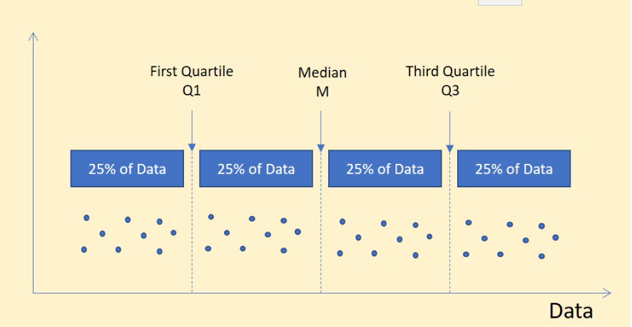
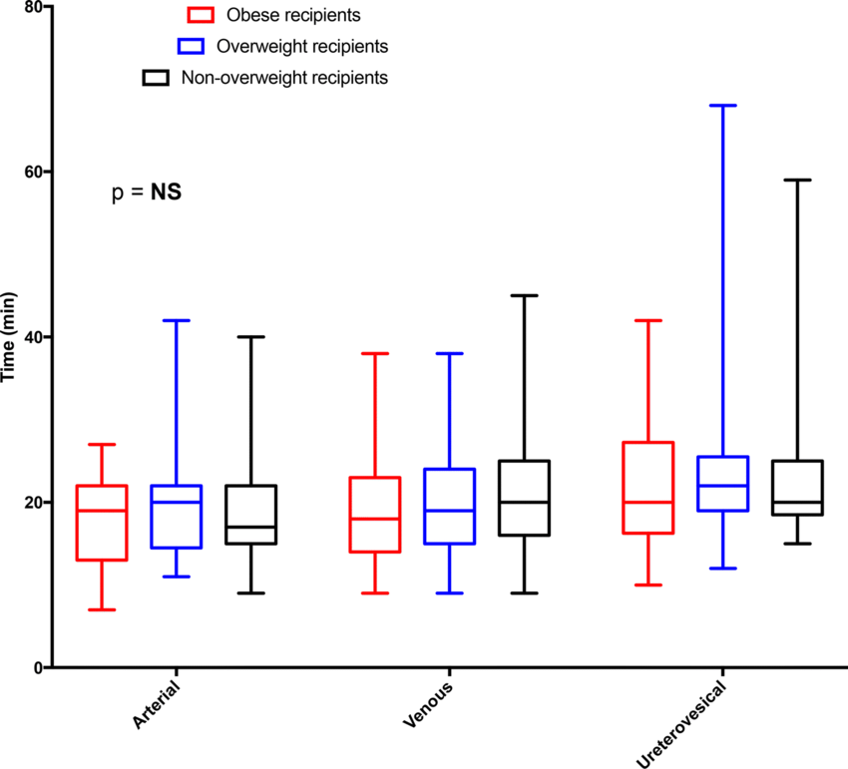
What are the types of univariate analysis?
Boxplot
A boxplot or whisker plot is a diagram often used for visualizing the distribution of numeric values. A boxplot divides the data into equal parts using the three quartiles, and this serves as an excellent visualization of distribution. A boxplot consists of the lowest value, the first quartile (Lower Quartile), the Second quartile (Median), the Third quartile (Upper Quartile), and finally, the highest value. A quartile is a statistical term used to describe the division of observations. The mentioned three quartiles divide the data into four equal parts.
https://www.enjoyalgorithms.com/blog/univariate-bivariate-multivariate-analysis

Slide 7
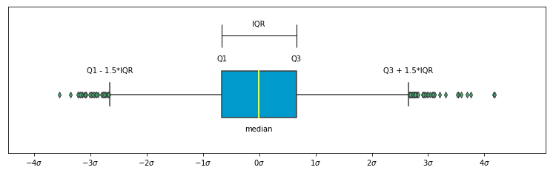
What are the types of univariate analysis?
Boxplot
This box plot is generated from a normal distribution, and because of that, it is approximately symmetric with respect to the middle yellow line.
The Inter Quartile Range (IQR) represents the middle 50% values. Each quartile to end or quartile covers 25% of the data. Hence, IQR is the difference between the third and the first quartile.
https://www.enjoyalgorithms.com/blog/univariate-bivariate-multivariate-analysis

Slide 8
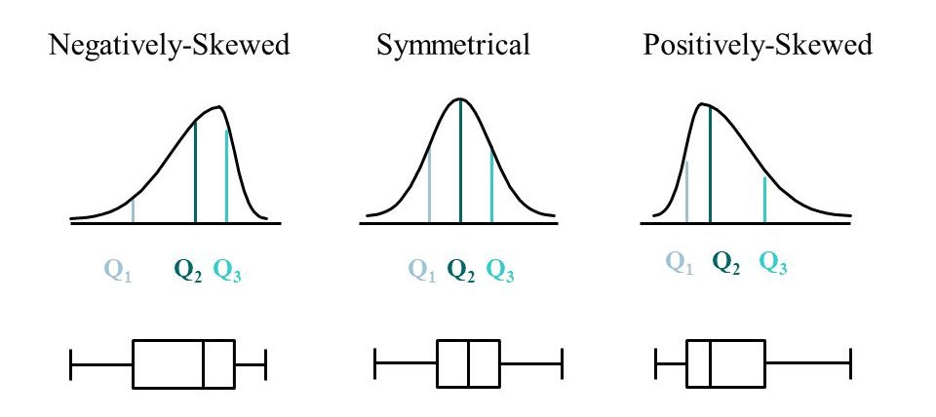
What are the types of univariate analysis?
Boxplot
IQR = (Third Quartile (Q3)- First Quartile (Q1))
IQR can be used to find the outliers in the data. A detailed approach has been discussed in this blog.
Boxplot can help in visualizing the distribution of data. The image below can distinguish the skewed distributions vs. the normal distribution pattern.
https://www.enjoyalgorithms.com/blog/univariate-bivariate-multivariate-analysis

Slide 9
What is Bivariate Analysis?
'Bi' means two, and 'variate' means variable. Collectively, Bivariate analysis refers to the exploratory data analysis between two variables. Now again, the variables can be either numeric or categorical. Bivariate analysis helps in studying the relationship between two variables, and if the two variables are related, we can comment on the strength of association
https://www.enjoyalgorithms.com/blog/univariate-bivariate-multivariate-analysis

Slide 10
What are the types of bivariate analysis?
We know the types of data can be either numerical or categorical. So there can be three types of scenarios:
Numerical feature vs. Numerical feature
Categorical feature vs. Categorical feature
Numerical feature vs. Categorical feature
https://www.enjoyalgorithms.com/blog/univariate-bivariate-multivariate-analysis

Slide 11
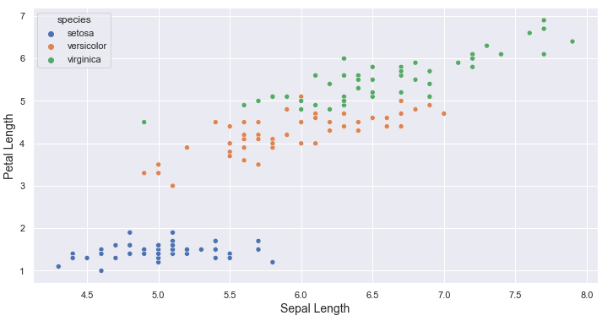
What are the types of bivariate analysis?
Scatter Plot (Numeric vs. Numeric)
A scatter plot or scatter graph is used to plot data points corresponding to two features. This helps explain the change in one variable with respect to the change in the other one. A dot in the scatterplot represents each row of the dataset. This also helps explain the correlation between two variables, but primarily, scatter plots are used to establish the relationship between two variables.
The above scatterplot clearly shows the presence of three distinct clusters of different flower species. On the X-axis, we have the Sepal length of the flower, while on the Y-axis, we have the Petal length. The scatterplot indicates a strong positive correlation between Sepal Length and Petal Length.
https://www.enjoyalgorithms.com/blog/univariate-bivariate-multivariate-analysis

Slide 12
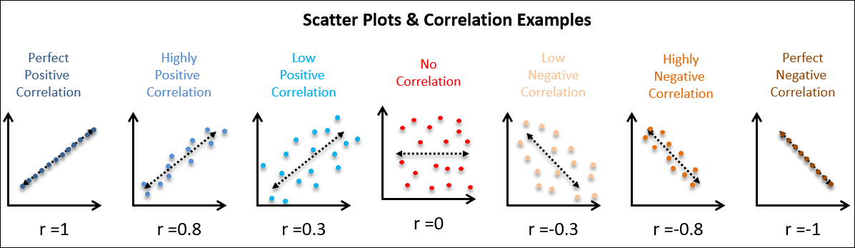
What are the types of bivariate analysis?
Scatter Plot (Numeric vs. Numeric) How can we comment on the correlation just by looking at the scatterplot? The image below will illustrate how we can comment on the correlation between two variables by looking at the scatterplot.
https://www.enjoyalgorithms.com/blog/univariate-bivariate-multivariate-analysis

Slide 13
What are the types of bivariate analysis?
Scatter Plot (Numeric vs. Numeric) How can we comment on the correlation just by looking at the scatterplot? The image below will illustrate how we can comment on the correlation between two variables by looking at the scatterplot. Correlation varies between -1 to 1. A correlation of positive one indicates a perfect positive linear relationship, while a negative one indicates a perfectly inverse relationship between two variables. Further, a correlation of zero indicates no connection between the two variables.
https://www.enjoyalgorithms.com/blog/univariate-bivariate-multivariate-analysis

Slide 14
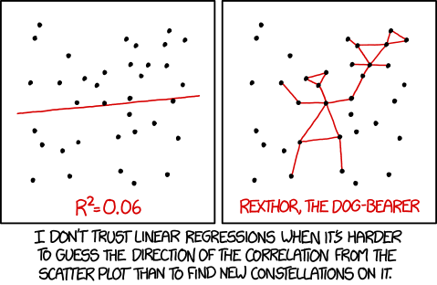
What are the types of bivariate analysis?
Scatter Plot (Numeric vs. Numeric
https://www.enjoyalgorithms.com/blog/univariate-bivariate-multivariate-analysis

Slide 15
What are the types of bivariate analysis?
Chi-Squared Test(Categorical vs. Categorical)
Chi-Squared Test is used to describe the relationship between categorical variables. It is a hypothesis test developed to test the statistical significance of the relationship between two categorical variables. It tells us whether the two variables are related or not. It works by calculating the Chi Statistics.
https://www.enjoyalgorithms.com/blog/univariate-bivariate-multivariate-analysis

Slide 16
What are the types of bivariate analysis?
Analysis of Variance: ANOVA (Continuous vs. Categorical)
ANOVA is a statistical test used to describe the potential differences in a continuous dependent variable by a categorical (Nominal) variable having two or more classes. It splits the observed variability in the data into two parts:
Systematic Factors
Random Factors
Systematic Factors have a statistically significant influence on the data, while the random factors don't add any information. ANOVA can explain the impact of an independent variable over the dependent variable. When there's only one dependent variable and one independent variable, it is known as one-way ANOVA.
https://www.enjoyalgorithms.com/blog/univariate-bivariate-multivariate-analysis

Slide 17
What is Multivariate Analysis?
'Multi' means many, and 'variate' means variable. Multivariate analysis refers to the statistical procedure for analyzing the data involving more than two variables. Alternatively, this can be used to analyze the relationship between dependent and independent variables. Multivariate analysis has various applications in clustering, feature selection, root-cause analysis, hypothesis testing, dimensionality reduction, etc.
https://www.enjoyalgorithms.com/blog/univariate-bivariate-multivariate-analysis

Slide 18
What are the methods used for multivariate analysis?
'Multi' means many, and 'variate' means variable. Multivariate analysis refers to the statistical procedure for analyzing the data involving more than two variables. Alternatively, this can be used to analyze the relationship between dependent and independent variables. Multivariate analysis has various applications in clustering, feature selection, root-cause analysis, hypothesis testing, dimensionality reduction, etc.
https://www.enjoyalgorithms.com/blog/univariate-bivariate-multivariate-analysis

Slide 19
What are the methods used for multivariate analysis?
We can easily correlate the multivariate with the unsupervised learning techniques in machine learning. Unsupervised learning techniques are used to analyze patterns present in the data. The popular methods associated with it are clustering and dimensionality reduction. Let's have a look at these techniques.
https://www.enjoyalgorithms.com/blog/univariate-bivariate-multivariate-analysis

Slide 20
What are the methods used for multivariate analysis?
Clustering Analysis
Clustering analysis segregates the data points into groups known as clusters. The data is grouped into clusters based on the similarity between the multivariate features. This data mining technique allows us to understand the data distribution based on the available features.
https://www.enjoyalgorithms.com/blog/univariate-bivariate-multivariate-analysis

Slide 21
What are the methods used for multivariate analysis?
Principal Component Analysis (PCA)
PCA is a dimensionality reduction technique frequently used to reduce the dimensions of large datasets that exhibit multicollinearity. In PCA, the original data is transformed into a new set of features such that a fewer number of transformed features explains the variance of the original dataset. This comes at a minimal loss of information.
https://www.enjoyalgorithms.com/blog/univariate-bivariate-multivariate-analysis

Slide 22
Lab Exercises:
Implement Univariate analysis (Mean, Variance, SD, Boxplot, Histogram, Barchart) for any chosen data set.
Implement Bivariate analysis (Scatter plot) for any chosen data set.
Implement Linear regression for any chosen data set
Implement Logistic regression for any chosen data set

Slide 23
Thanks
Notes:
https://www.amrita.edu/news/amrita-surya-vahini-solar-auto-rickshaw

